Slide 1

Welcome to BookMyMandap: Your Dream Venue Awaits
Discover the hassle-free way to find and book Mandaps, designed to connect users and providers effortlessly. Our platform creates seamless event experiences by simplifying the entire venue booking journey.
Group Members:- Akshay Londhe Vaishnavi Laddha Tanay Phadke
Kunal Hulke

Slide 2

The Problem: Traditional Venue Booking is a Headache
Time-Consuming Searches
Lack of Transparency
Pricing and venue availability remain unclear, frustrating users and providers alike.
Users spend over 40 hours navigating through scattered information, making endless phone calls to find a suitable Mandap.
Disorganized Process
Poor communication and outdated listings result in inefficient booking experiences.

Slide 3
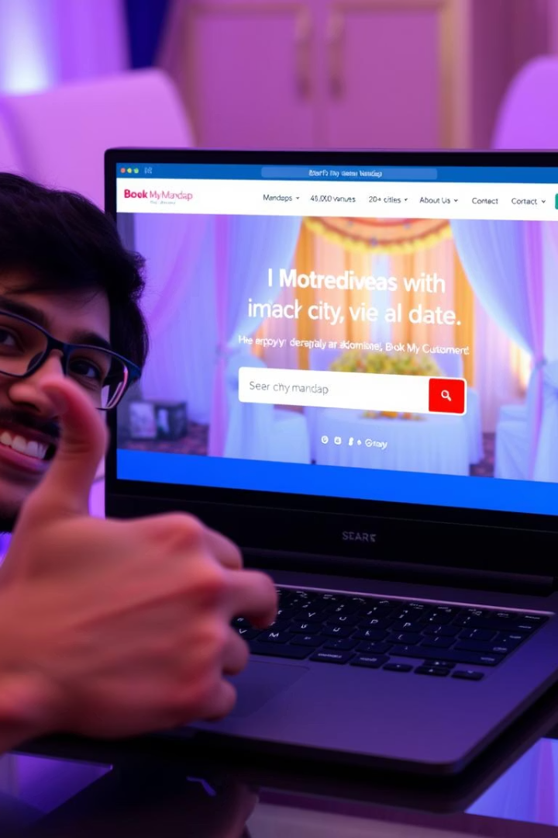
Our Solution: BookMyMandap - Simplifying Venue Booking
Unified Platform
Streamlined Experience
Connecting users directly with Mandap providers on a single easy-to-use platform.
Efficient search, booking, and management tools reduce time and effort.
Transparent & Organized
Clear pricing, availability, and secure transactions ensure trust and convenience.

Slide 4



Technology Stack Behind BookMyMandap
Frontend Technologies
React.js for dynamic UI
Sonner for elegant notifications
Backend & Database
React Big Calendar for scheduling
Node.js runtime server-side
Recharts for visual data
Express.js API framework
Moment.js for date handling
Bcrypt for password security
Ant Design UI components
Nodemon for live reloads
Zustand for state management
JWT for secure authentication
Typewriter-effect for animations
MongoDB for NoSQL data storage
React Router for navigation
Tailwind CSS for fast styling

Slide 5
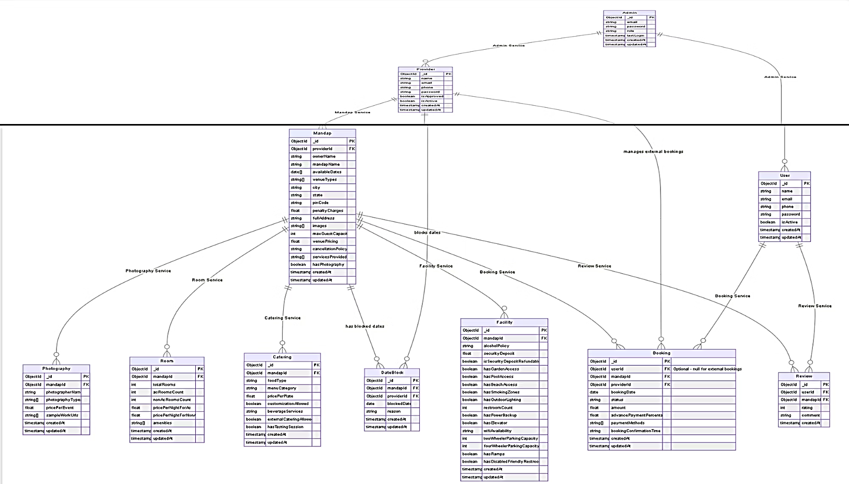
Entity-Relationship Diagram

Slide 6
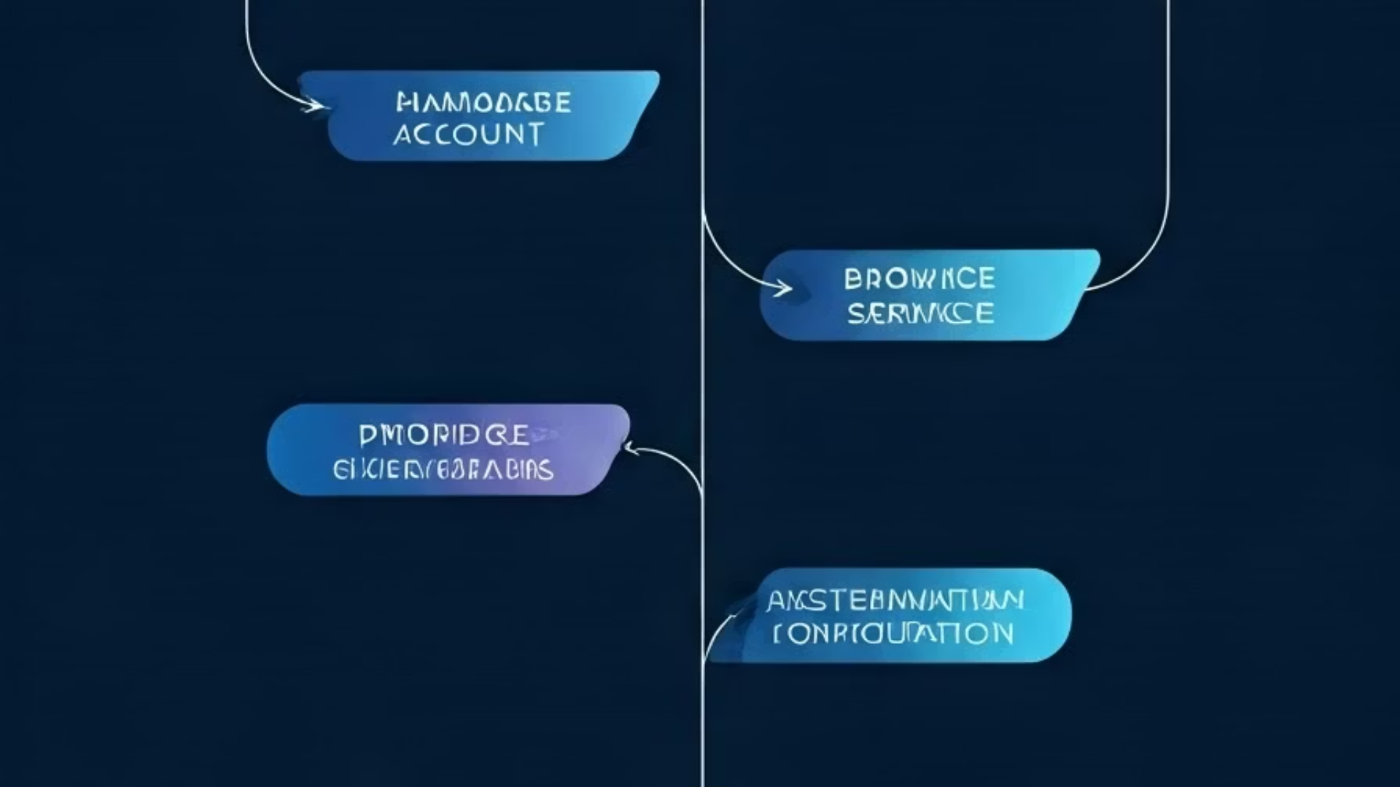
BookMyMandap’s Use Case Diagrams
Explore the core actors driving our platform: Users, Providers, and Admins.

Slide 7
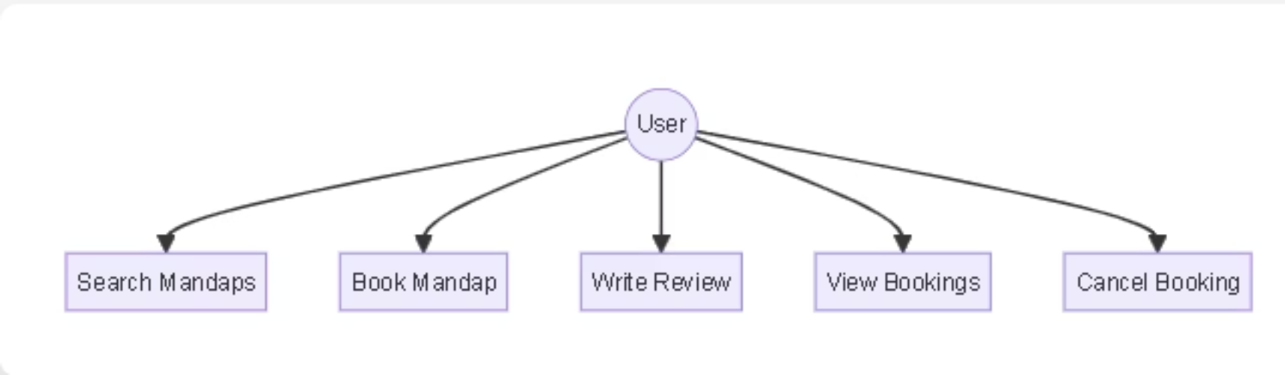
User's Use Case Diagram

Slide 8
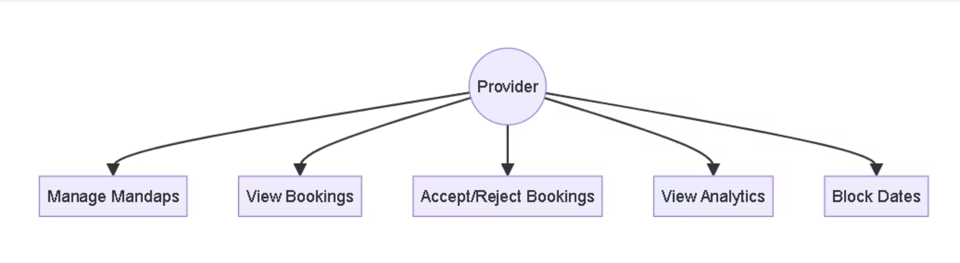
Provider's Use Case Diagram

Slide 9
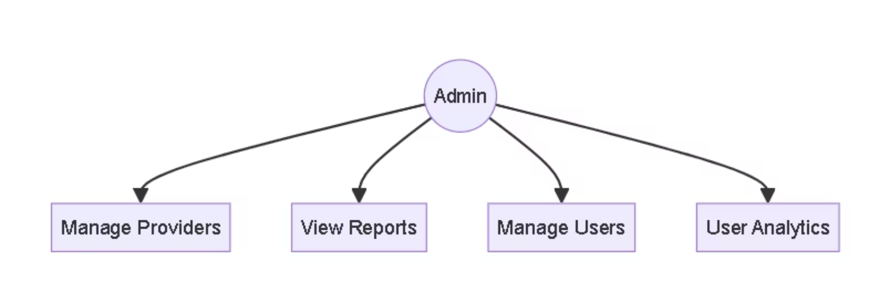
Admin's Use Case Diagram

Slide 10



User Flow Overview
User Journey
Search venues, view availability, book and manage event details seamlessly.
Provider Workflow
Register Mandaps, update listings, manage bookings, and track payments efficiently.
Admin Controls
Oversee platform users, verify providers, and maintain smooth operations securely.

Slide 11
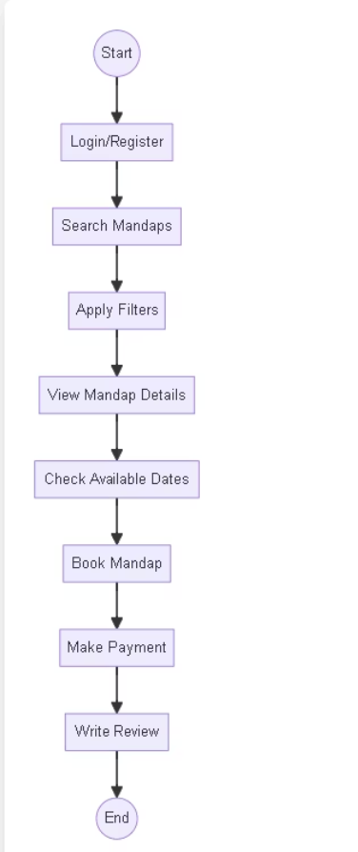
User's User Flow Diagram

Slide 12
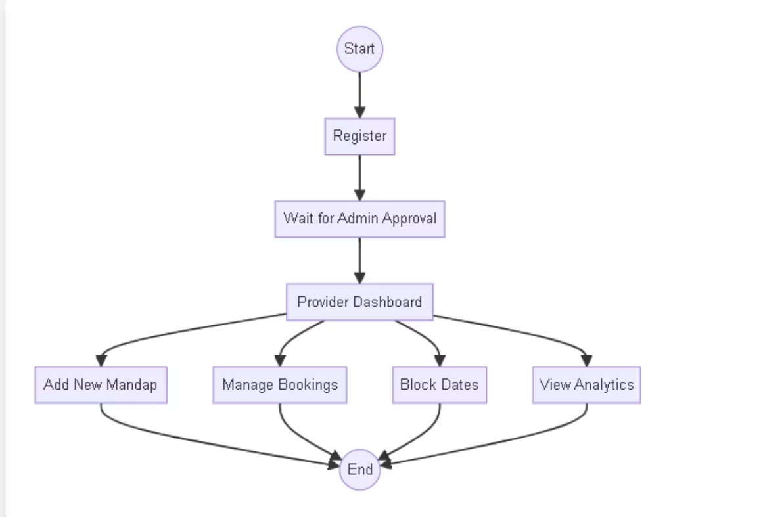
Provider's Flow Diagram

Slide 13
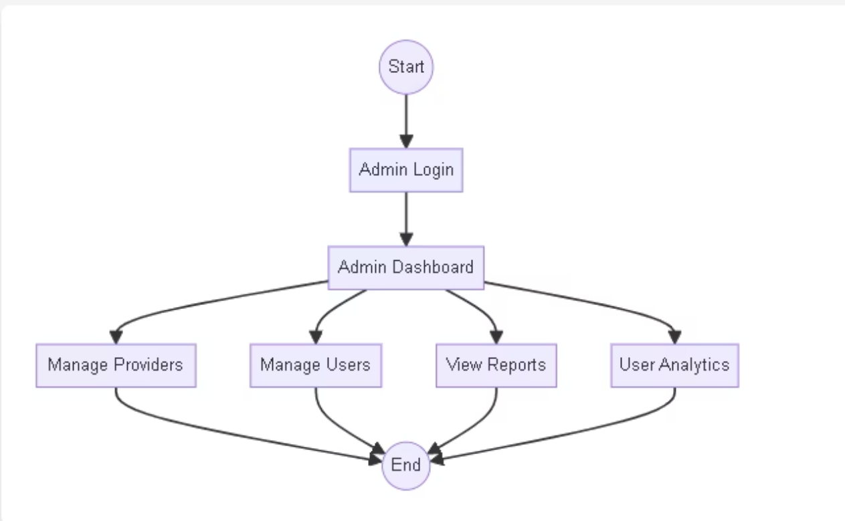
Admin's Flow Diagram

Slide 14

USER’S PERSPECTIVE

Slide 15
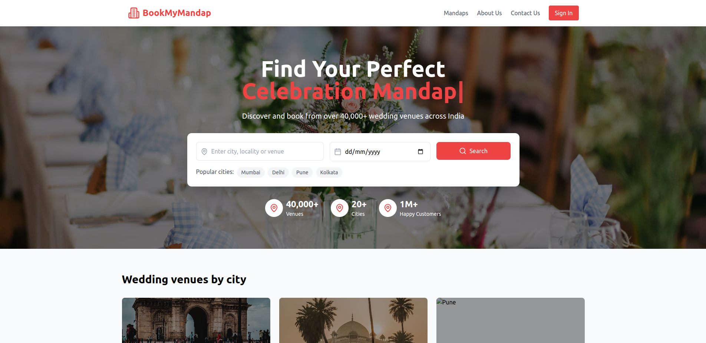
Home Page

Slide 16
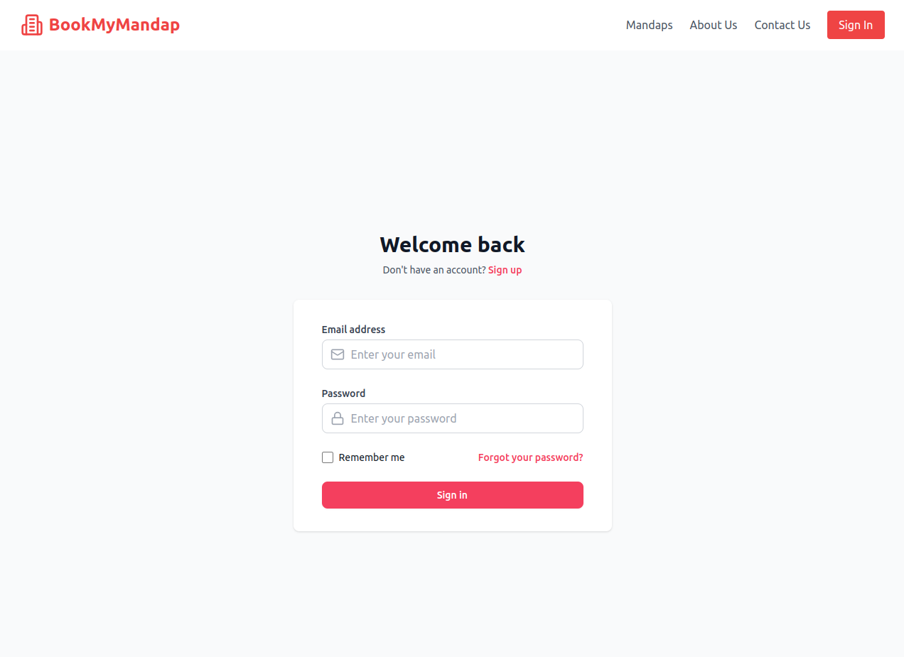
Sign-in Page

Slide 17
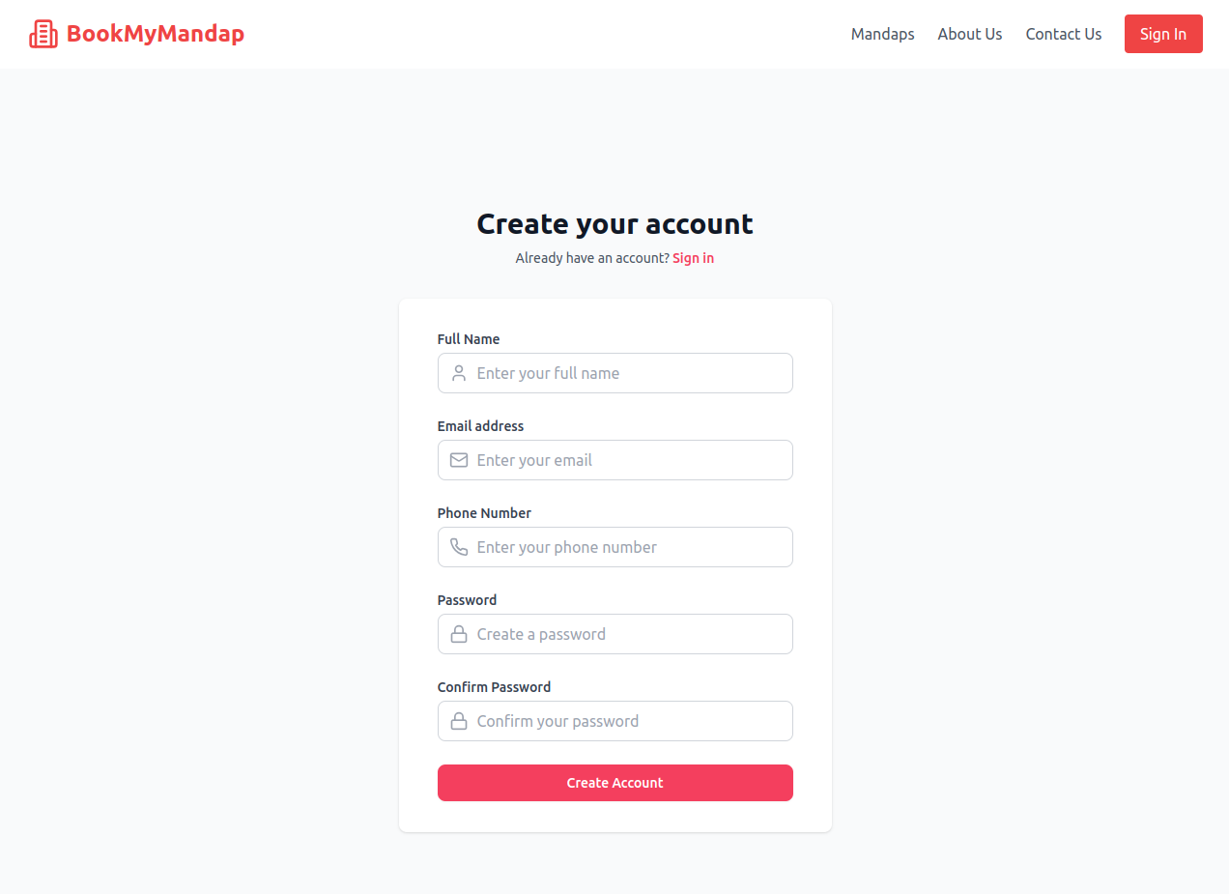
Registration Page

Slide 18
Navigation Bar

Slide 19
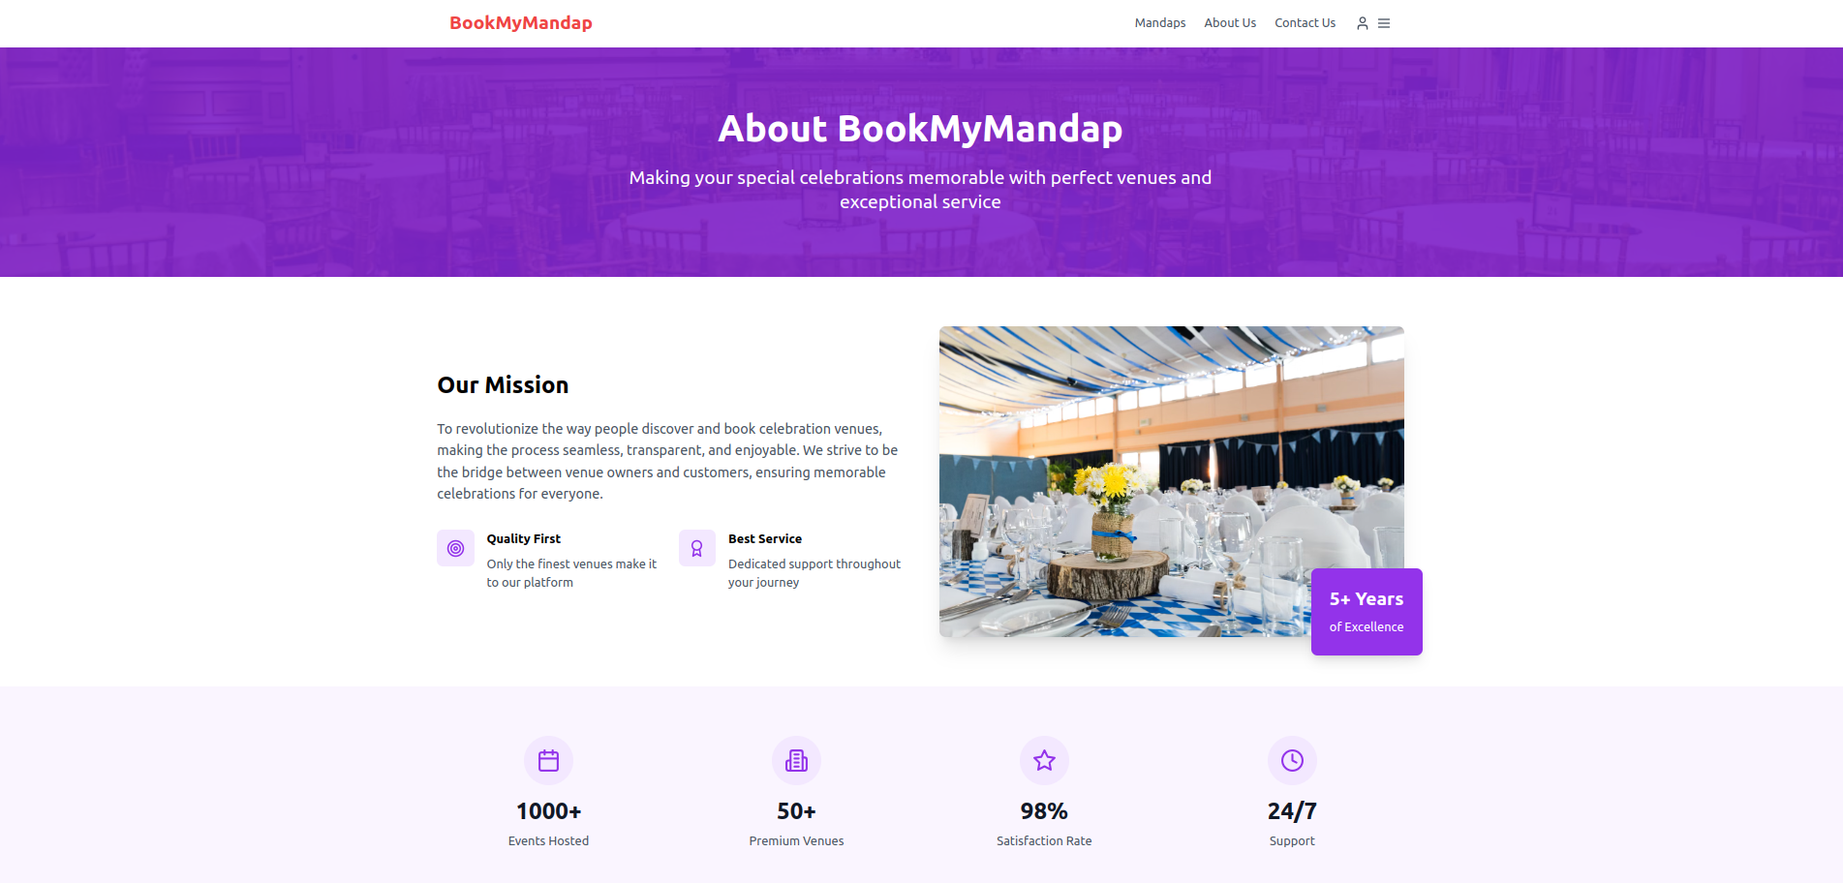
About Us

Slide 20
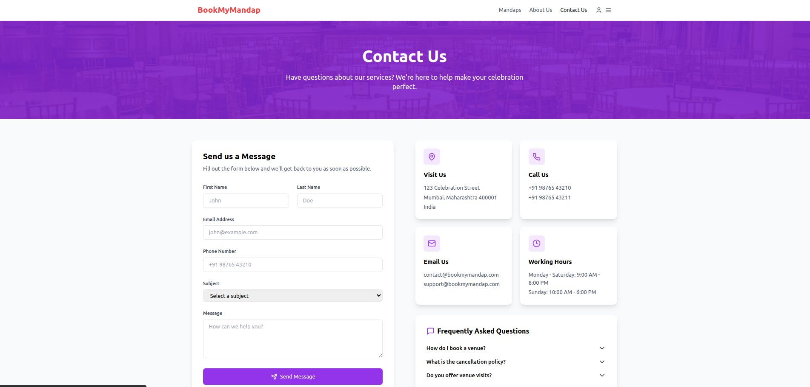
Contact Us

Slide 21
Home Page – Section 1

Slide 22
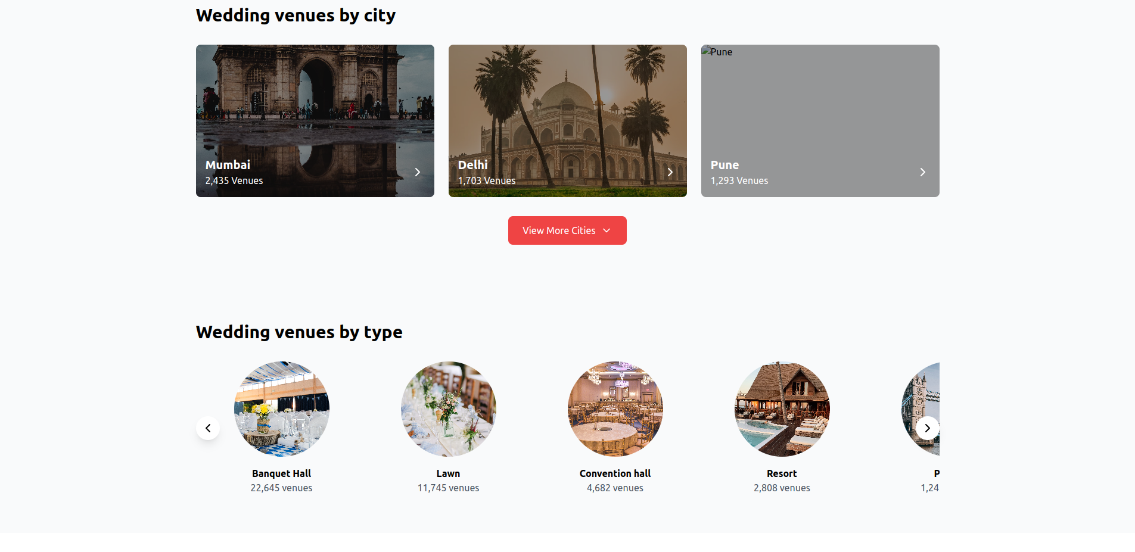
Home Page – Section 2 & 3

Slide 23
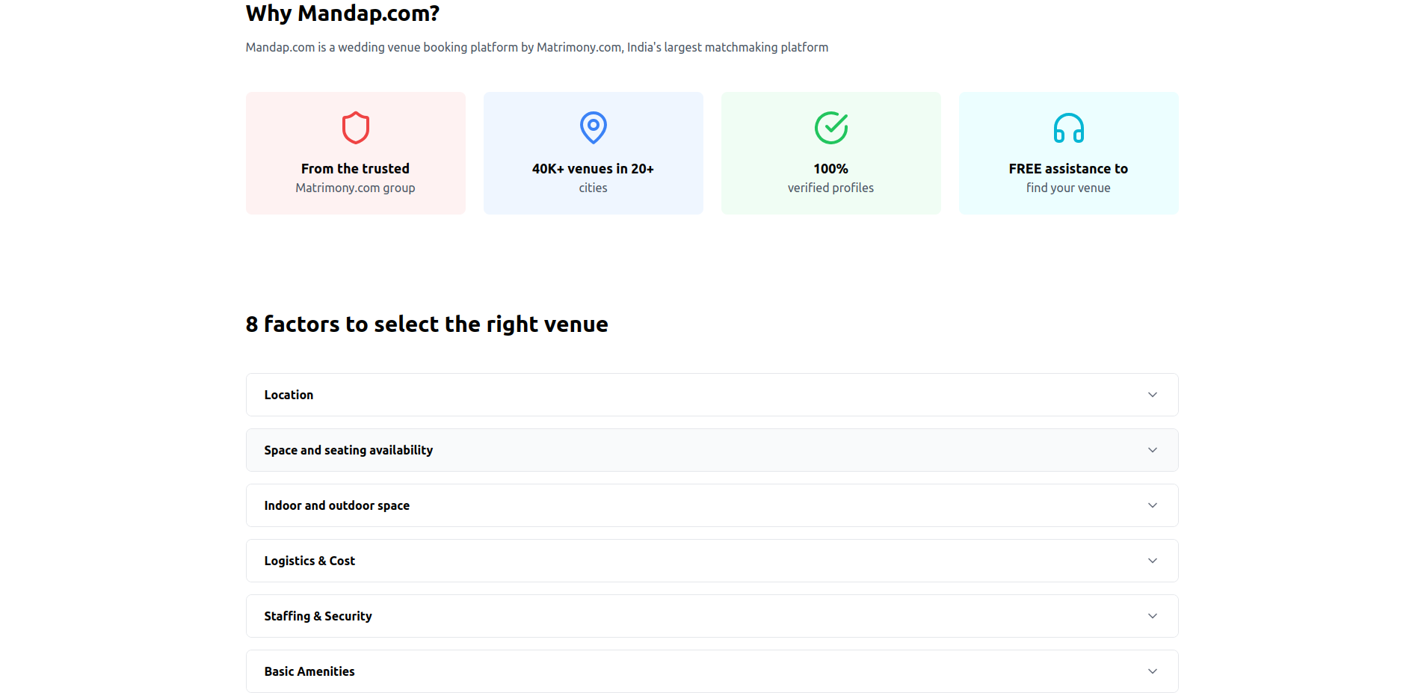
Home Page – Section 5

Slide 24
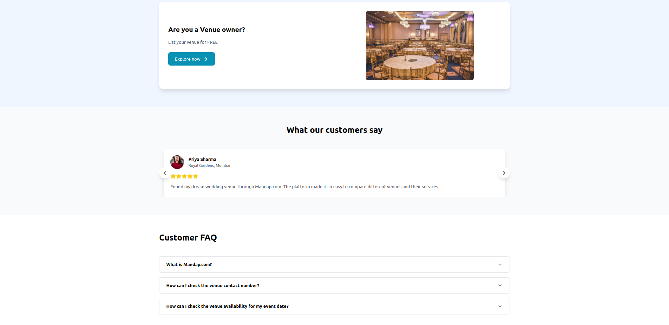
Home Page – Provider login, FAQ and testimonials

Slide 25
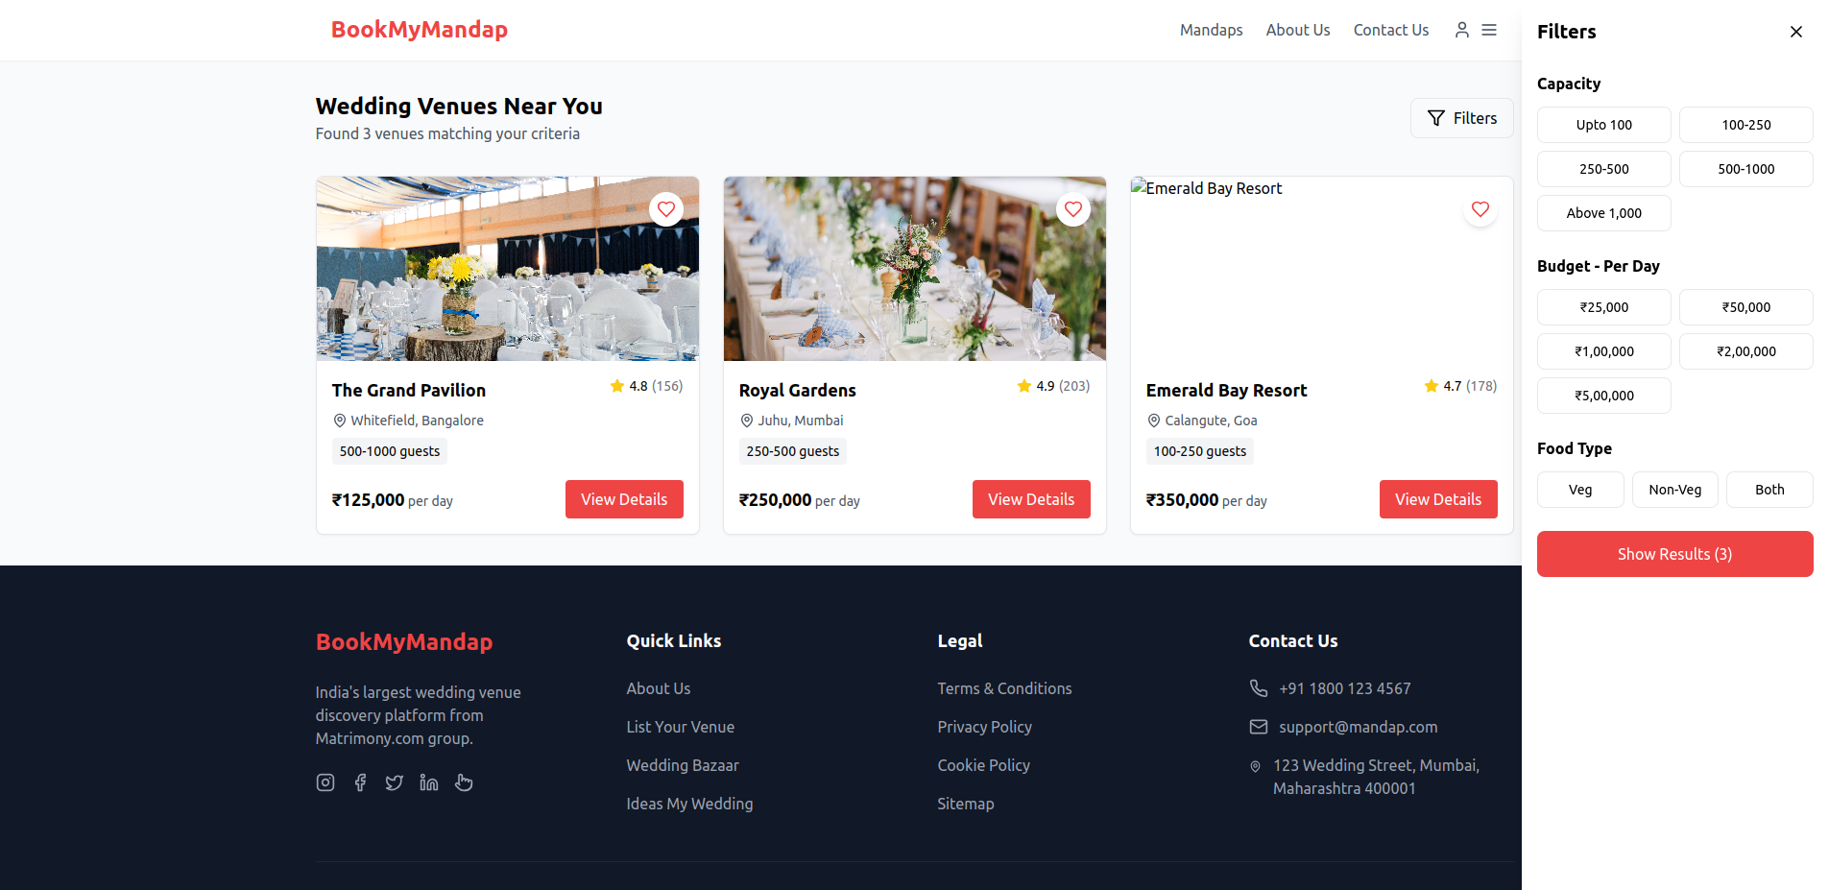
Venue List page

Slide 26
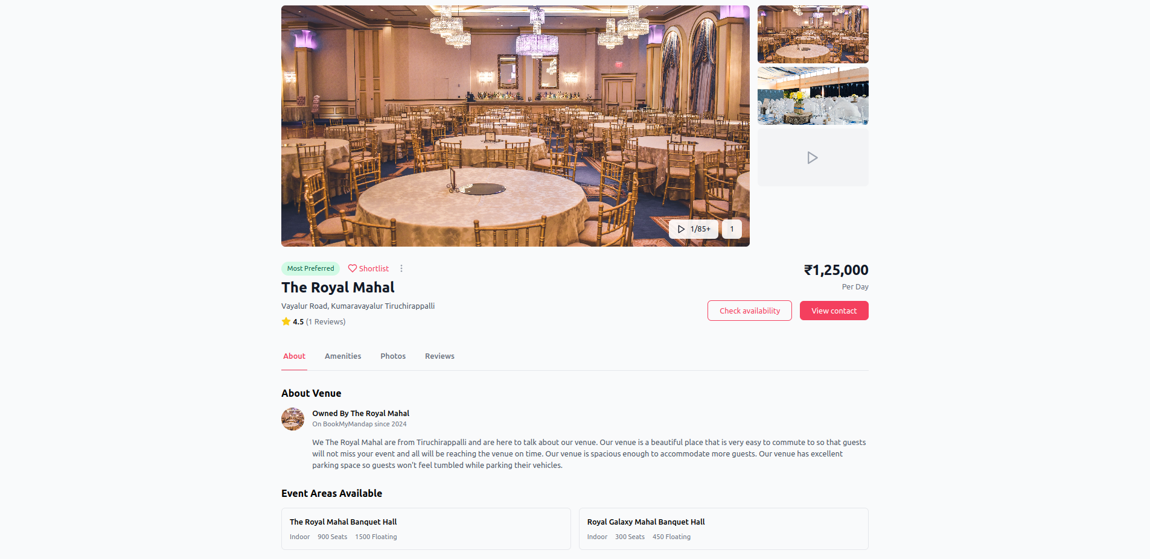
Venue details page

Slide 27
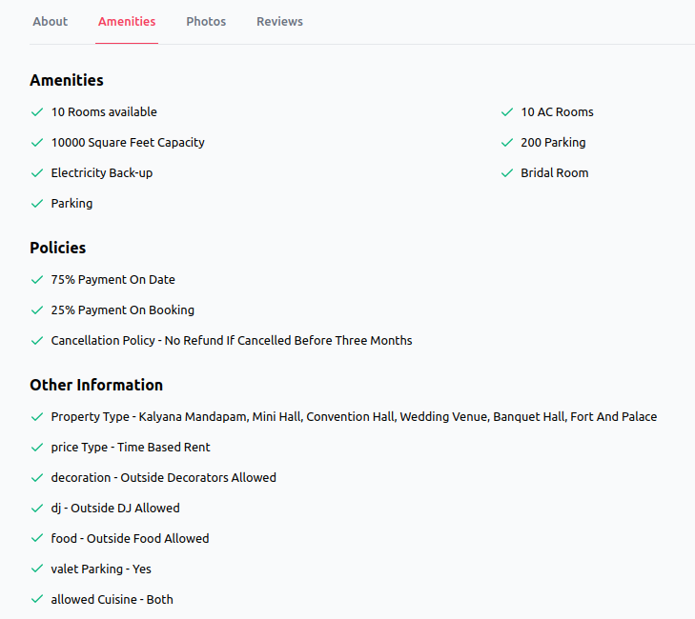
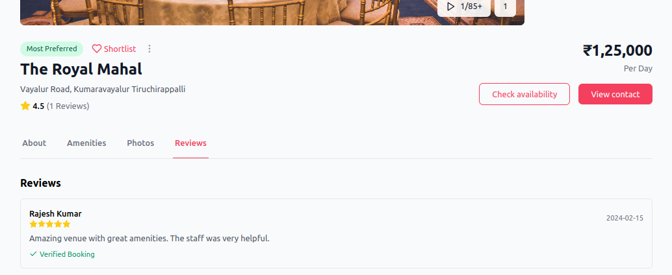
Venue details page

Slide 28
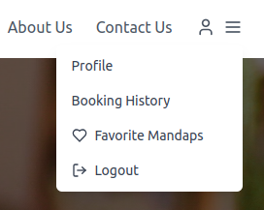
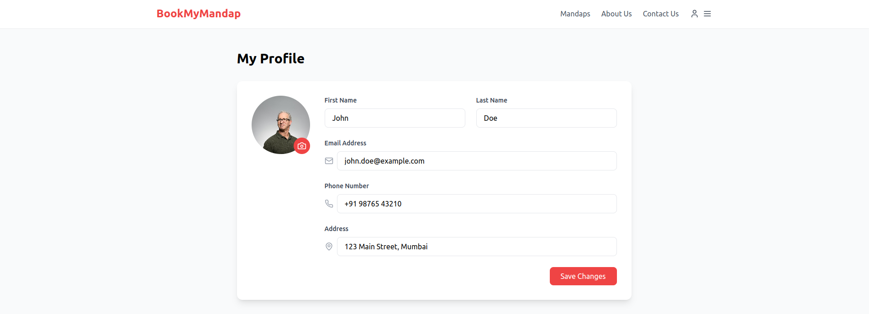
Profile management page

Slide 29
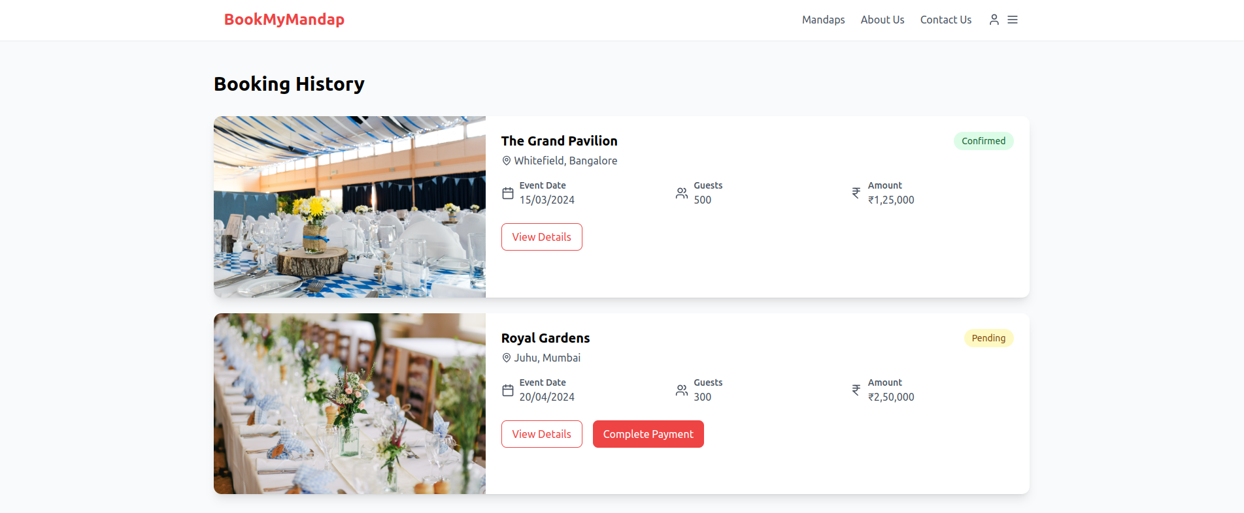
Booking history

Slide 30
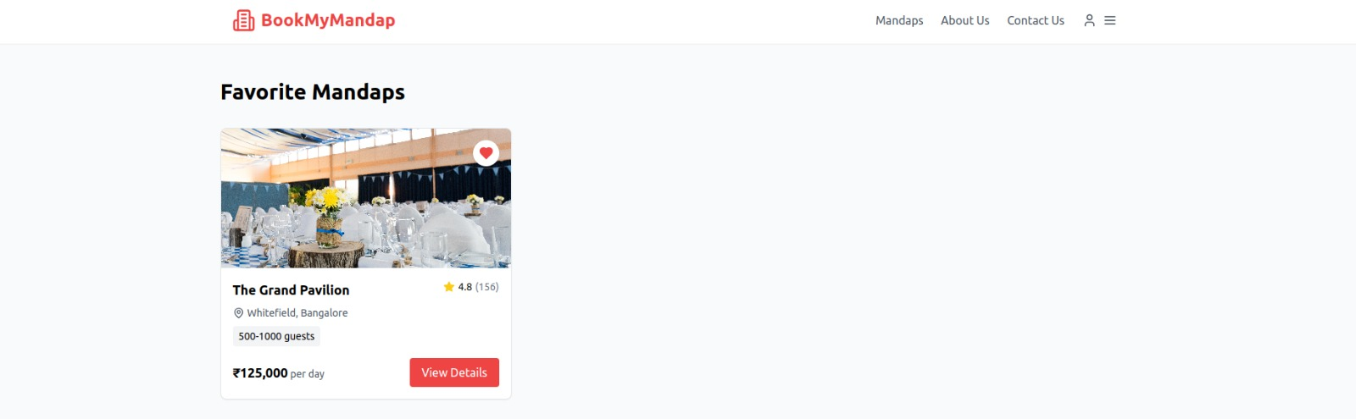
Favourites List

Slide 31
PROVIDER'S PERSPECTIVE

Slide 32
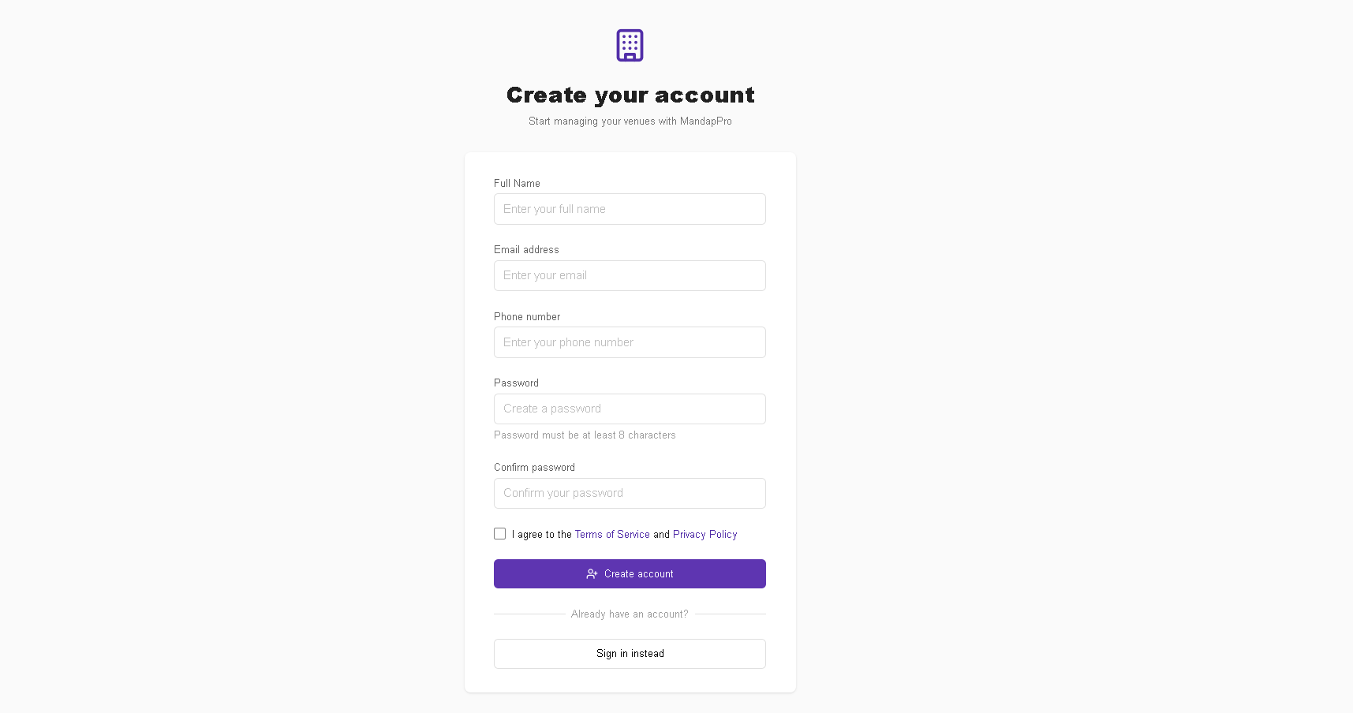
Provider Registration Page

Slide 33
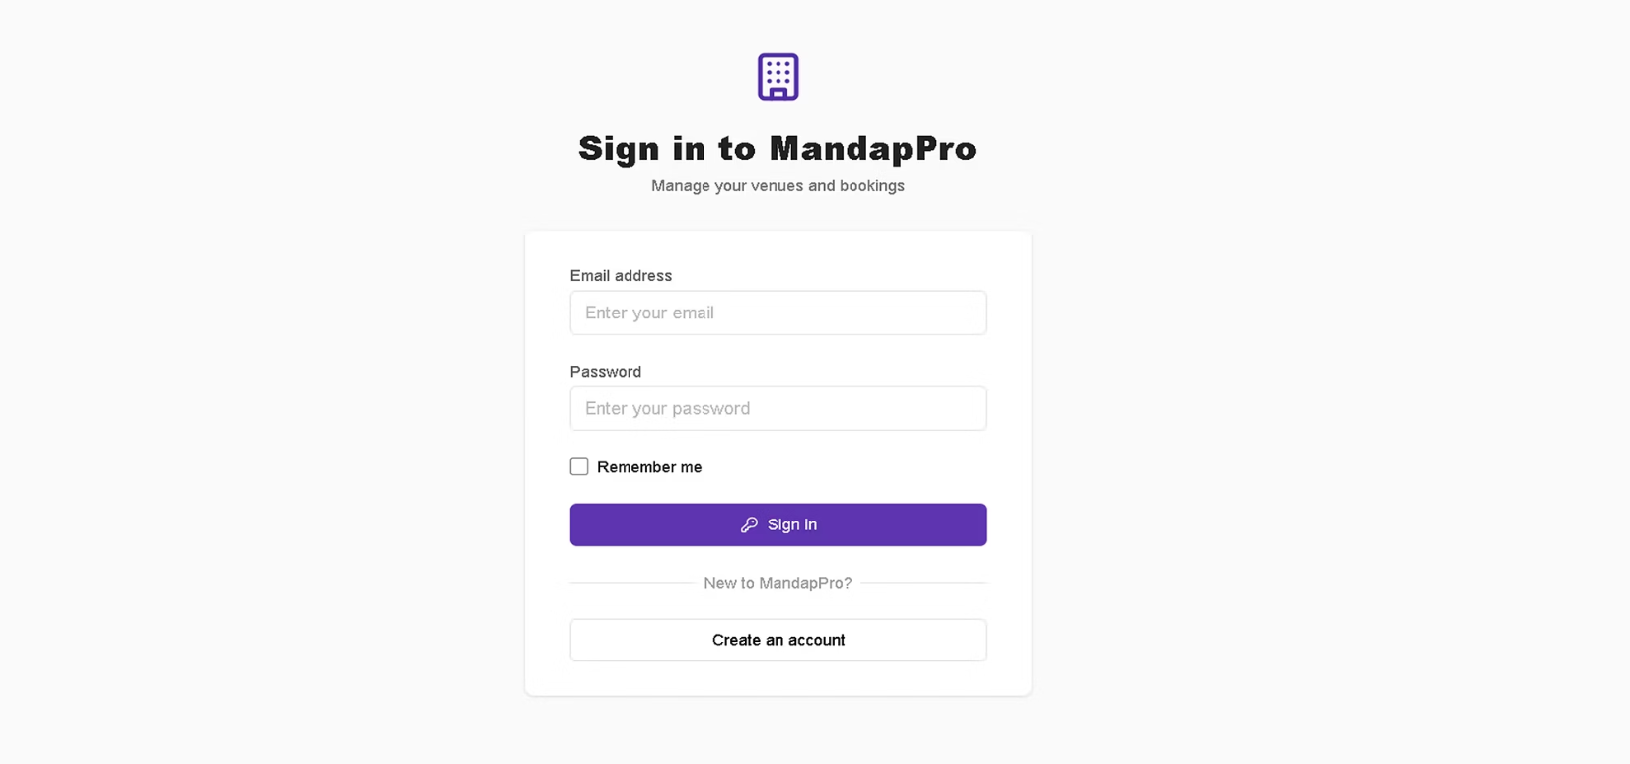
Provider Login Page

Slide 34
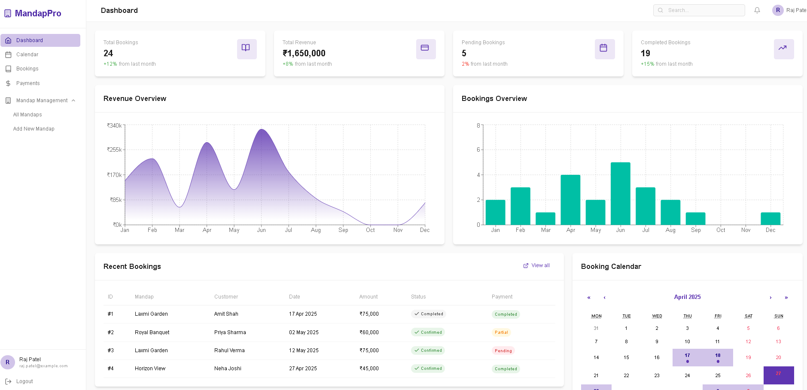
Provider Dashboard

Slide 35
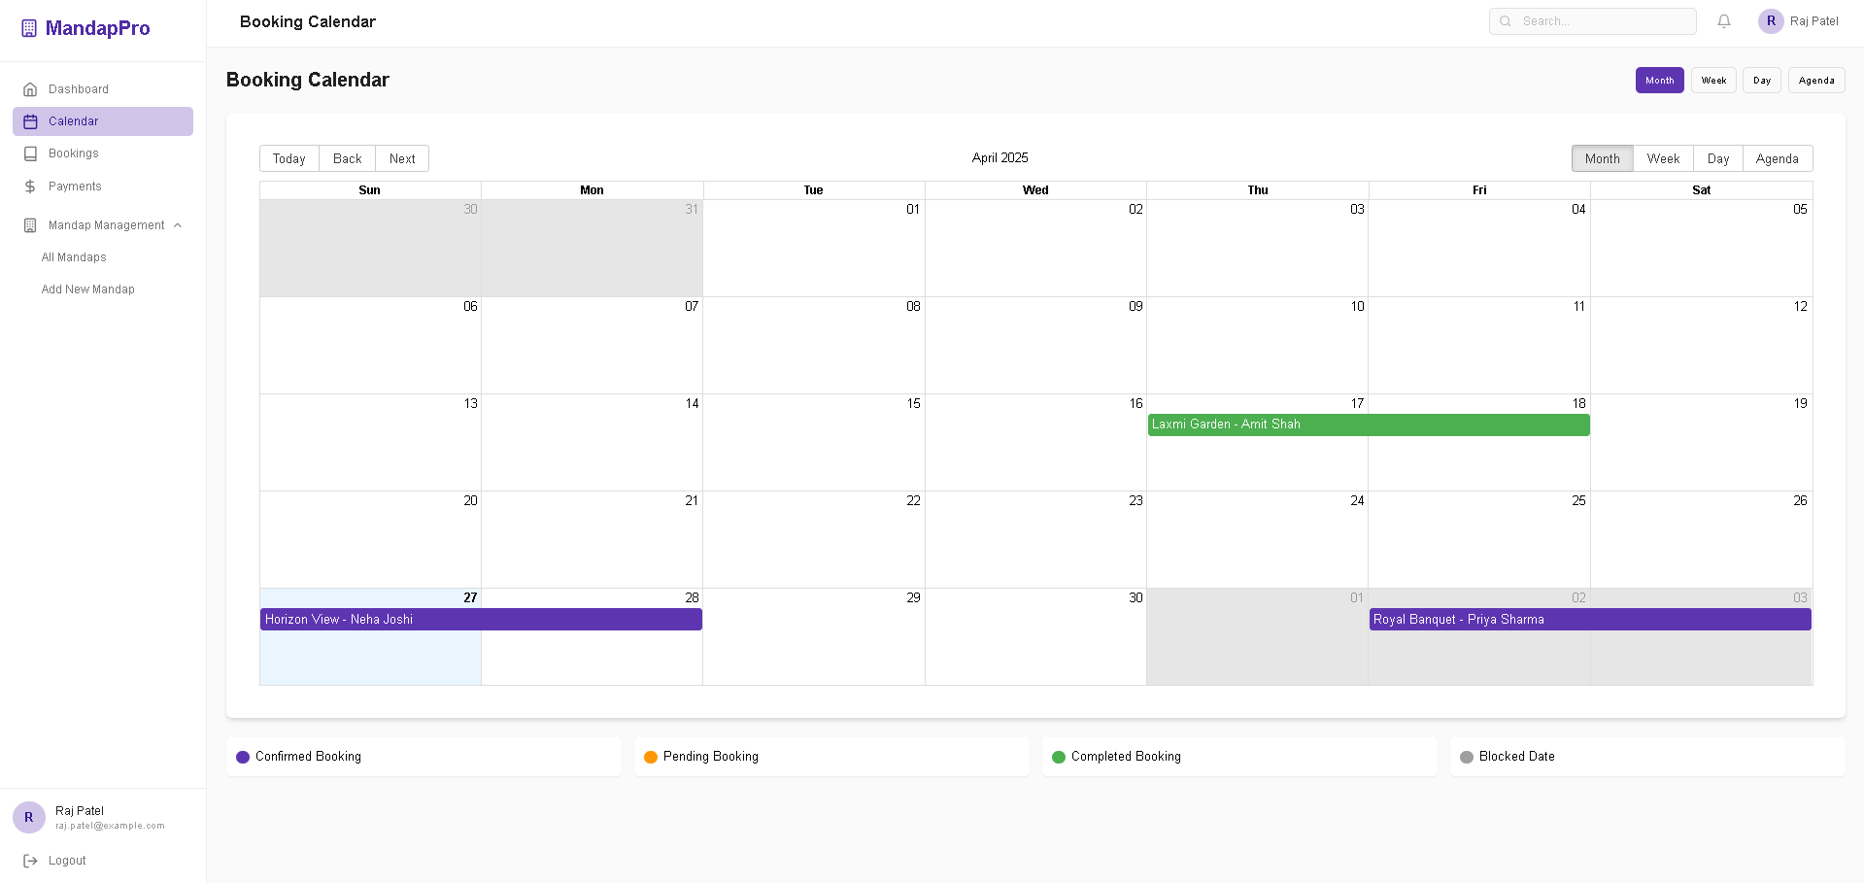
Booking Calendar

Slide 36
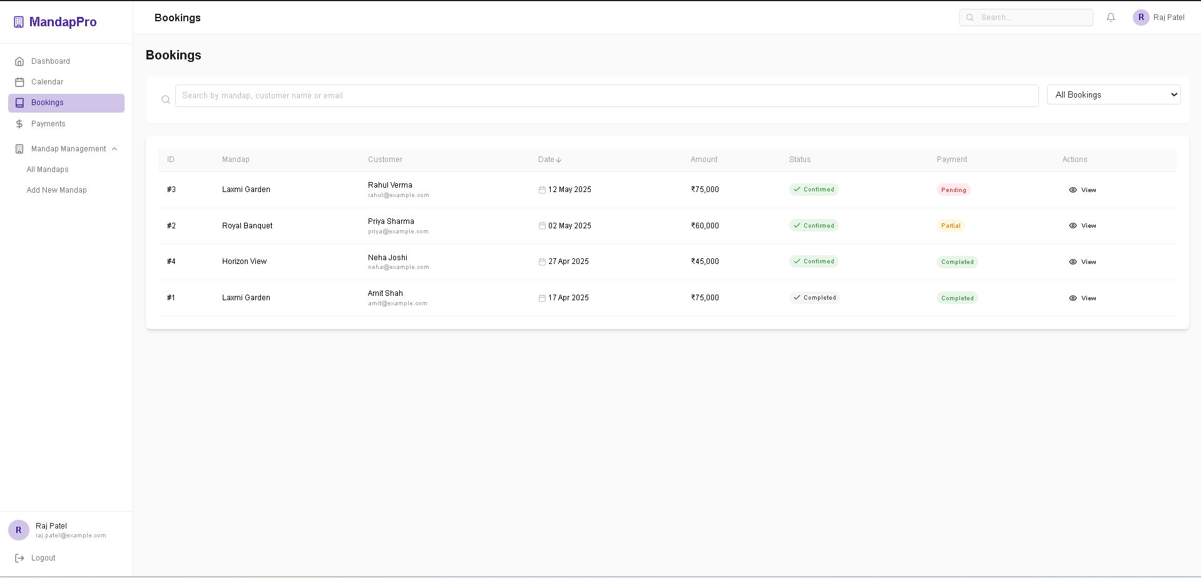
Provider's Bookings

Slide 37
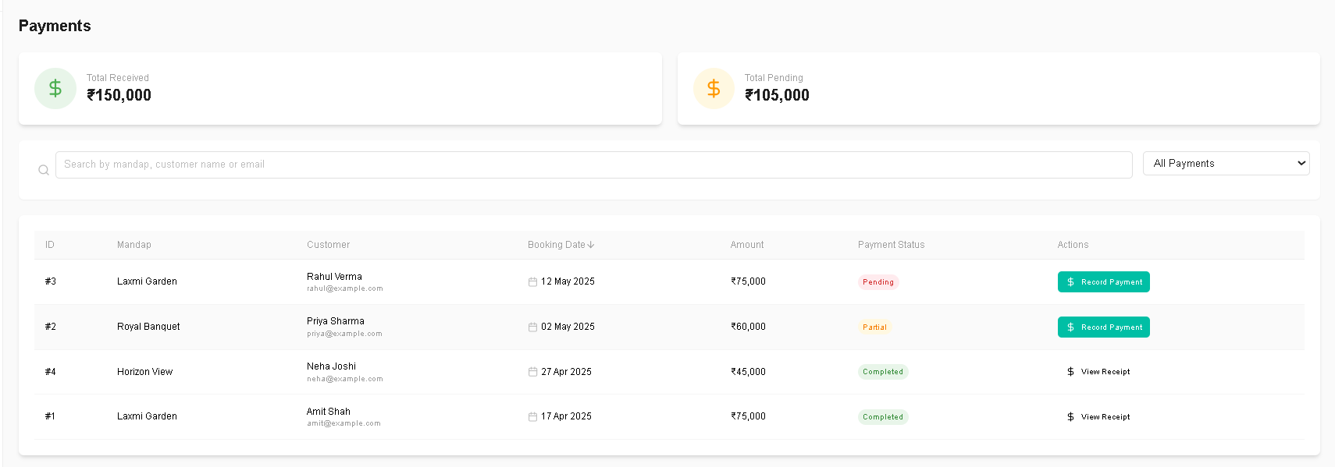
Payment History

Slide 38
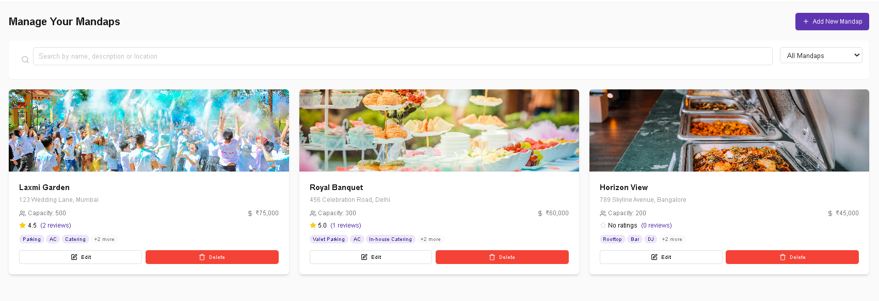
Manage Your Mandap

Slide 39
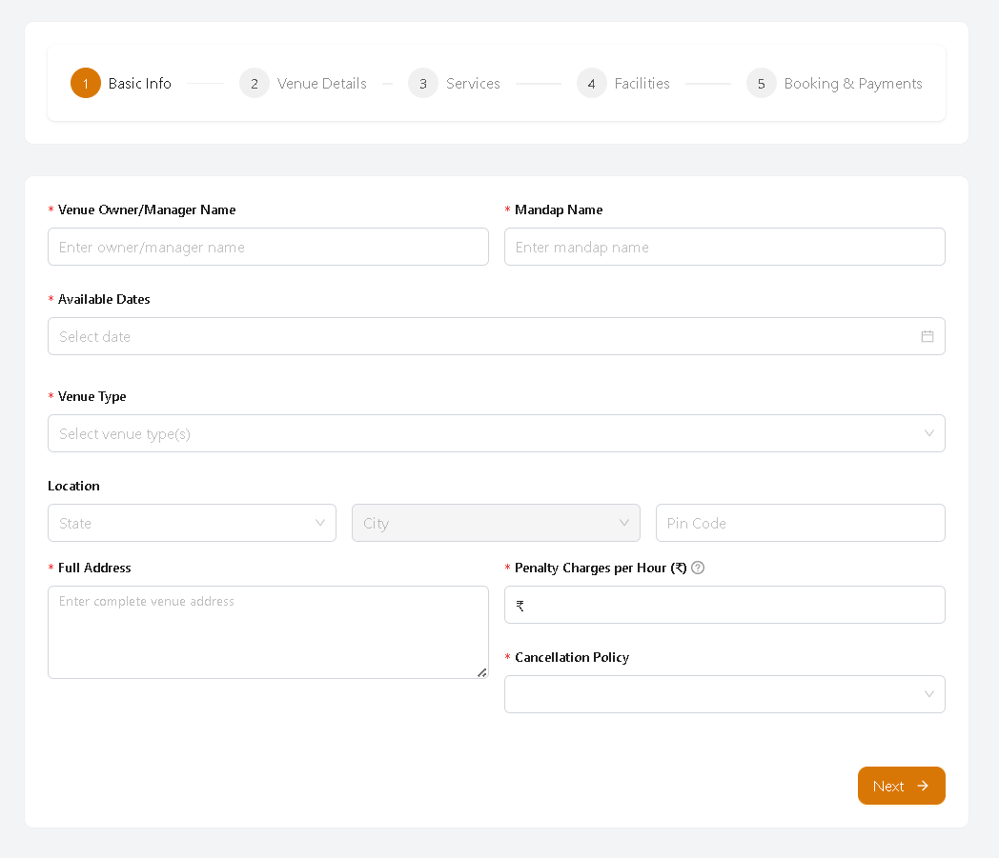
Add New Mandap

Slide 40
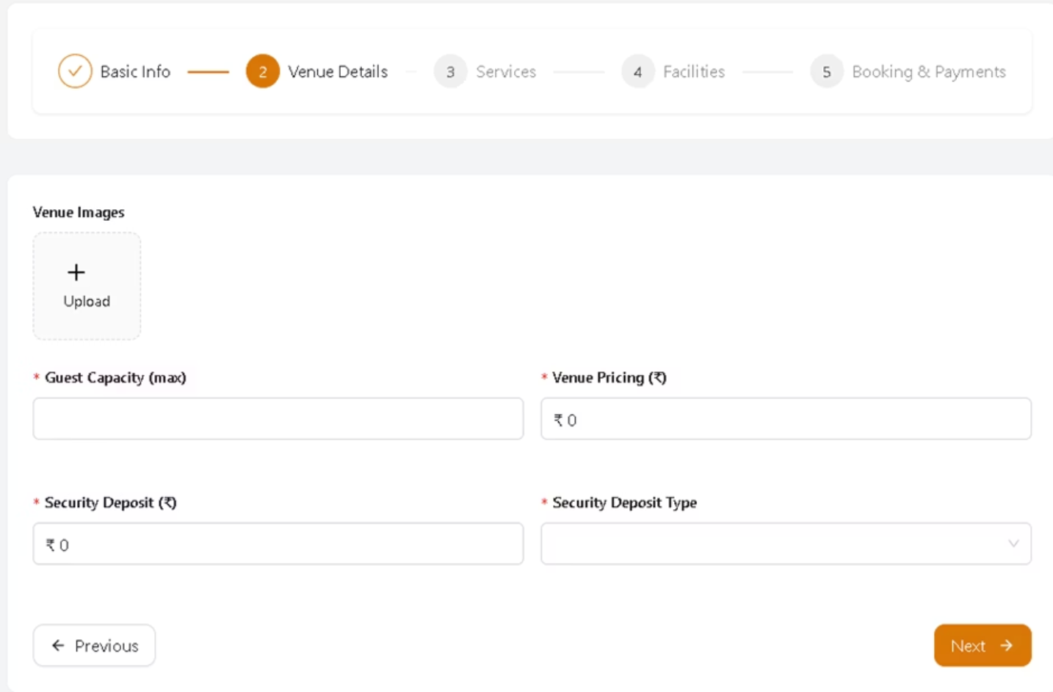

Slide 41
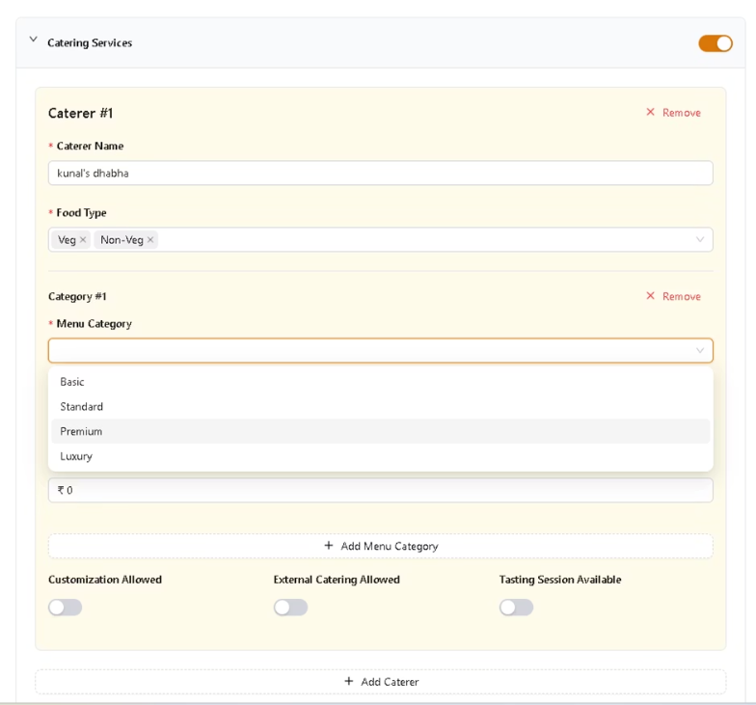
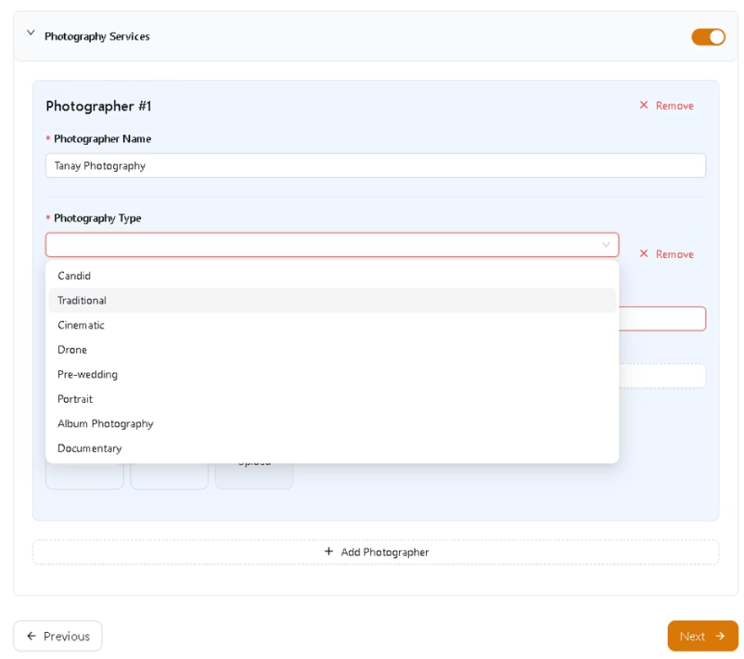

Slide 42
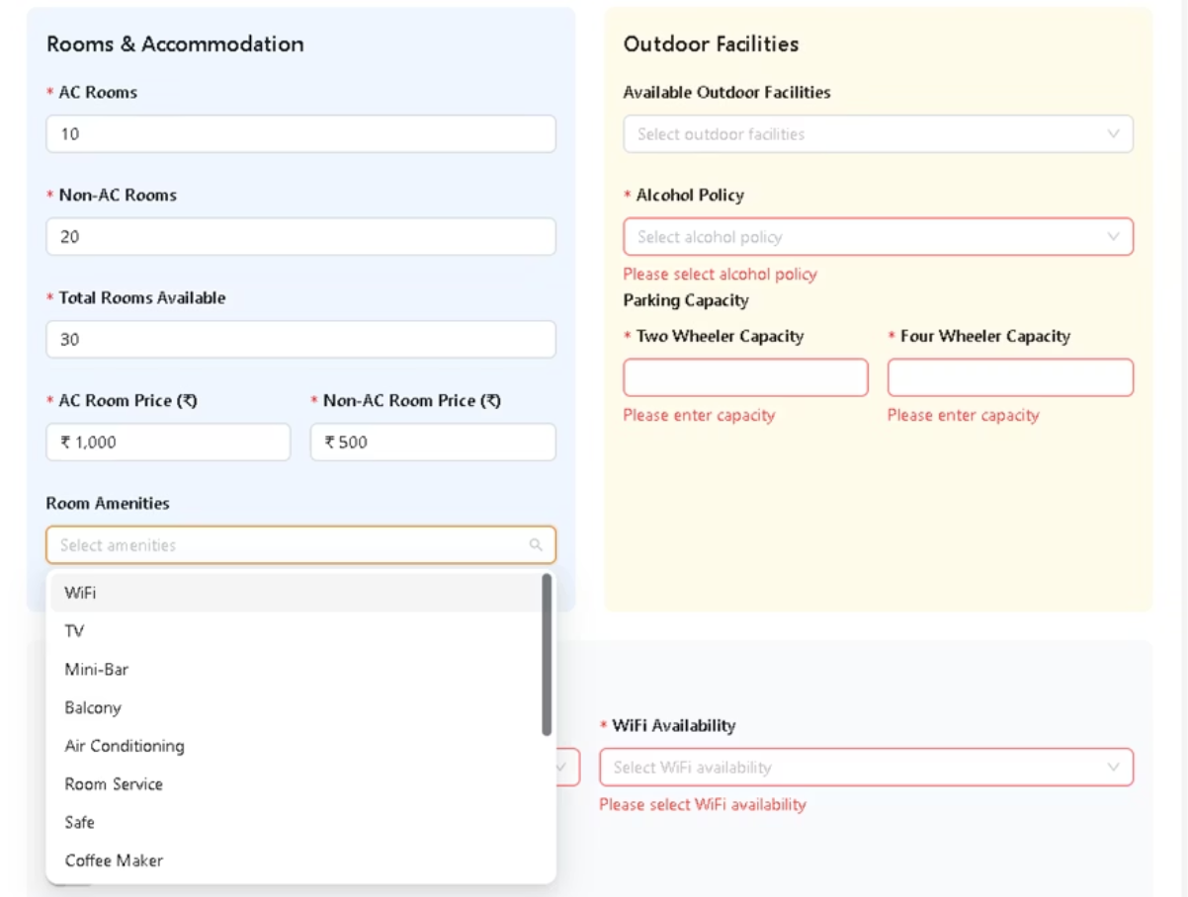

Slide 43
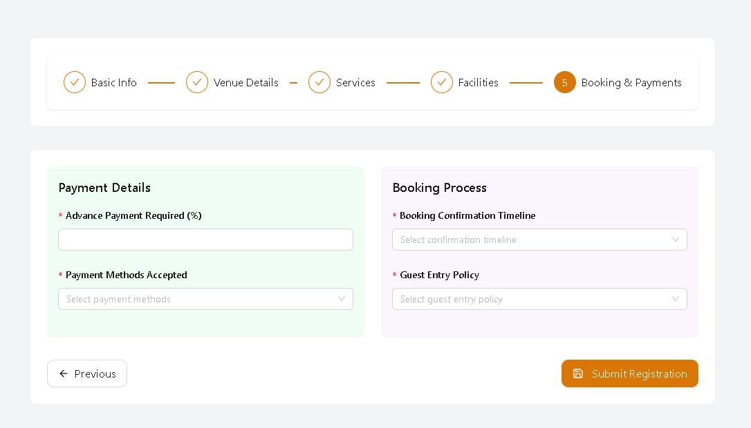

Slide 44
ADMIN PERSPECTIVE

Slide 45
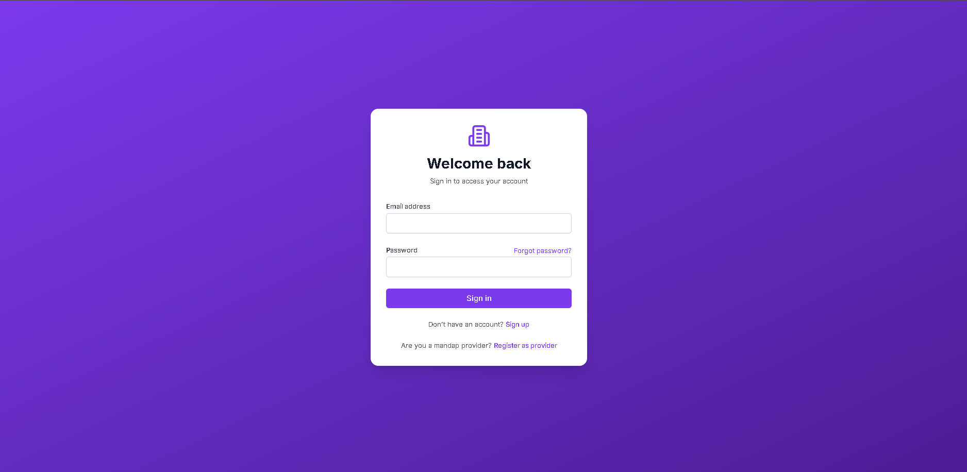
Admin Login

Slide 46
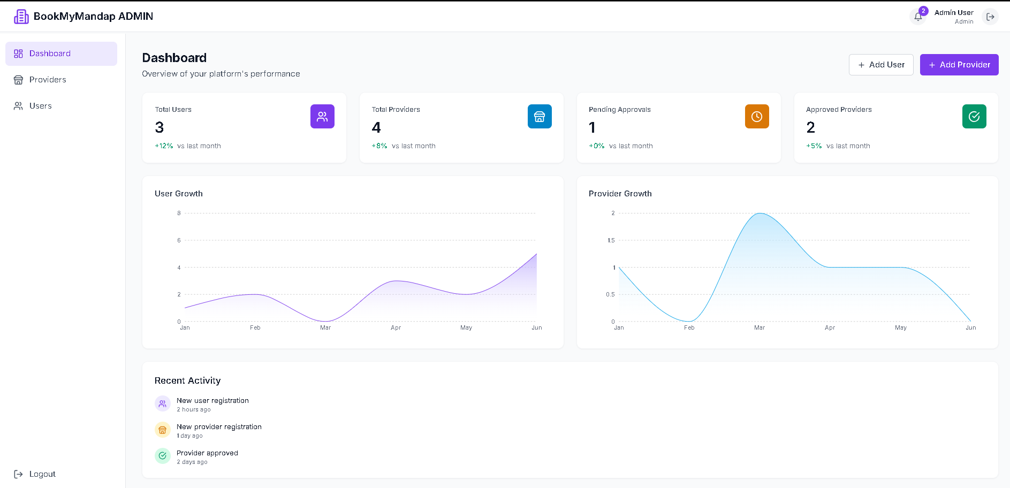
Admin Dashboard

Slide 47
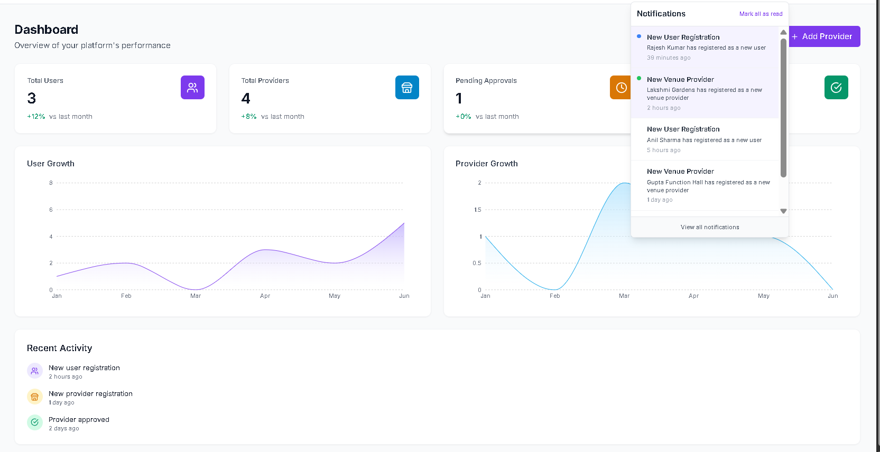

Slide 48
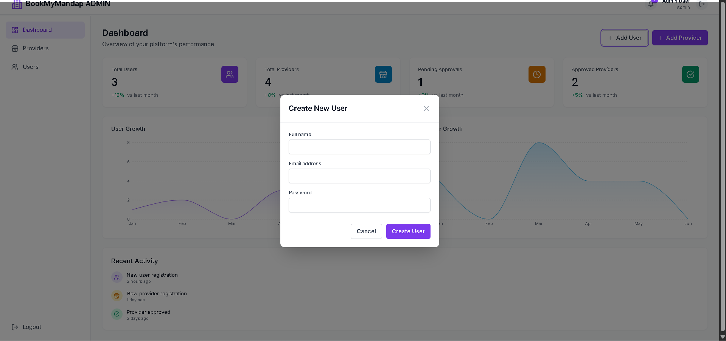
Add User

Slide 49
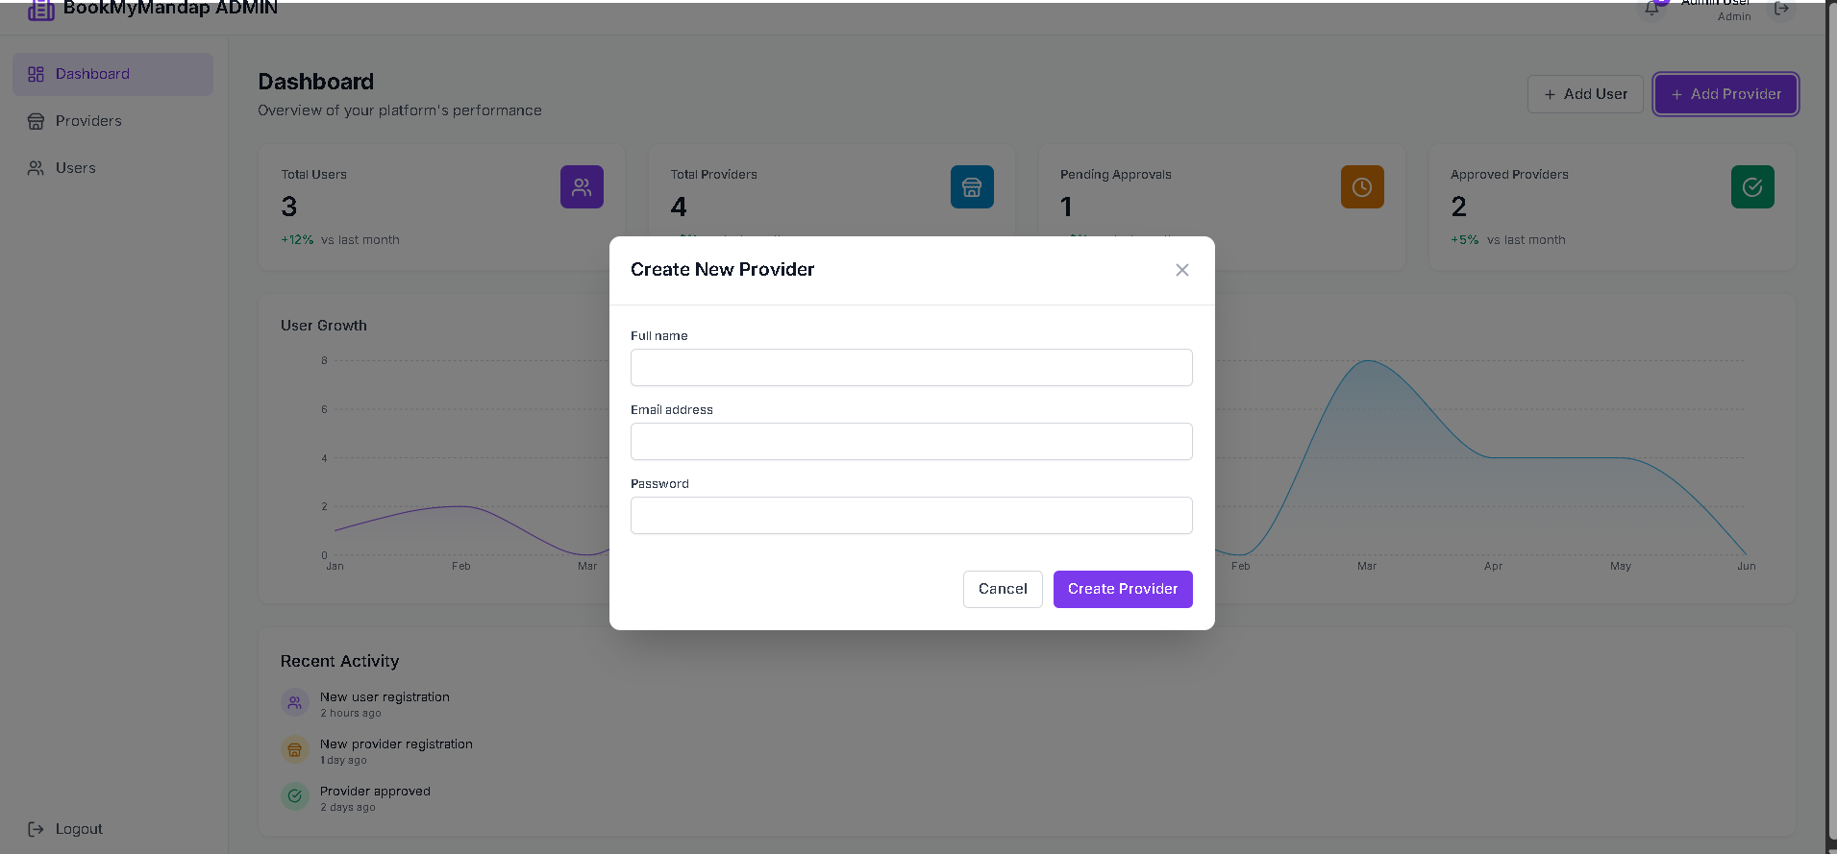
Add Provider

Slide 50
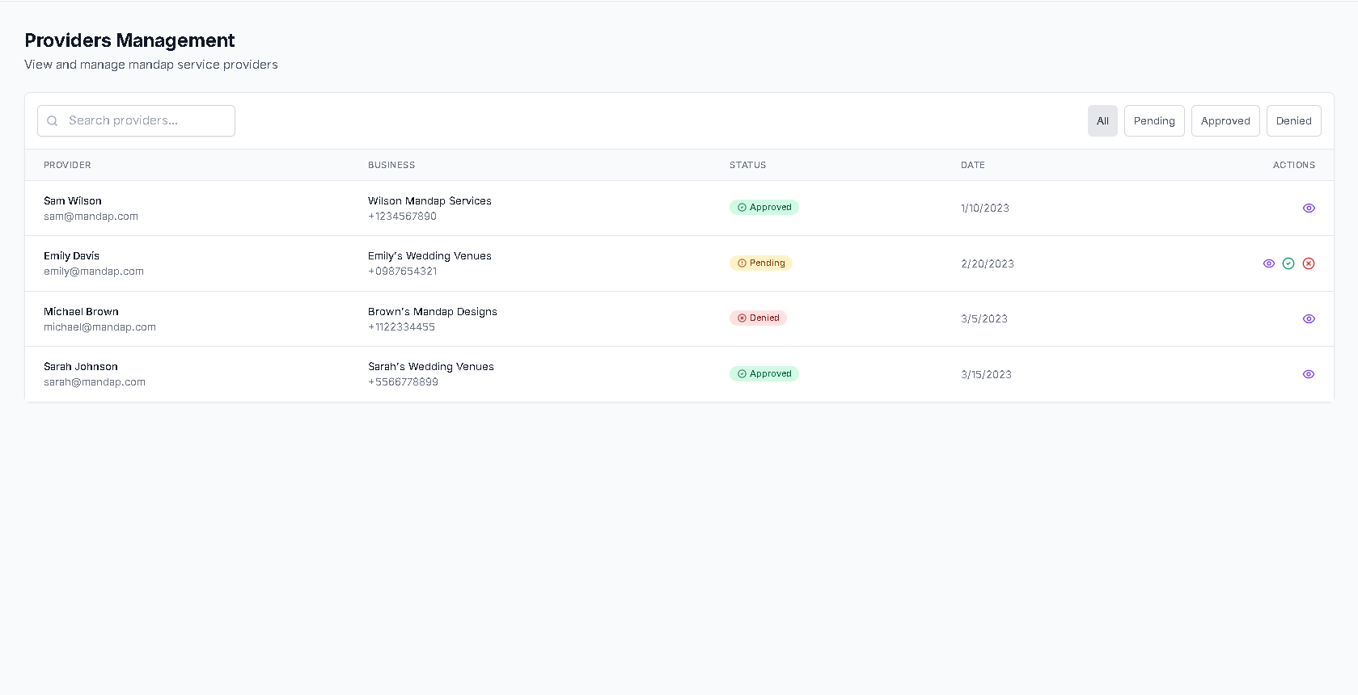
Manage provider

Slide 51
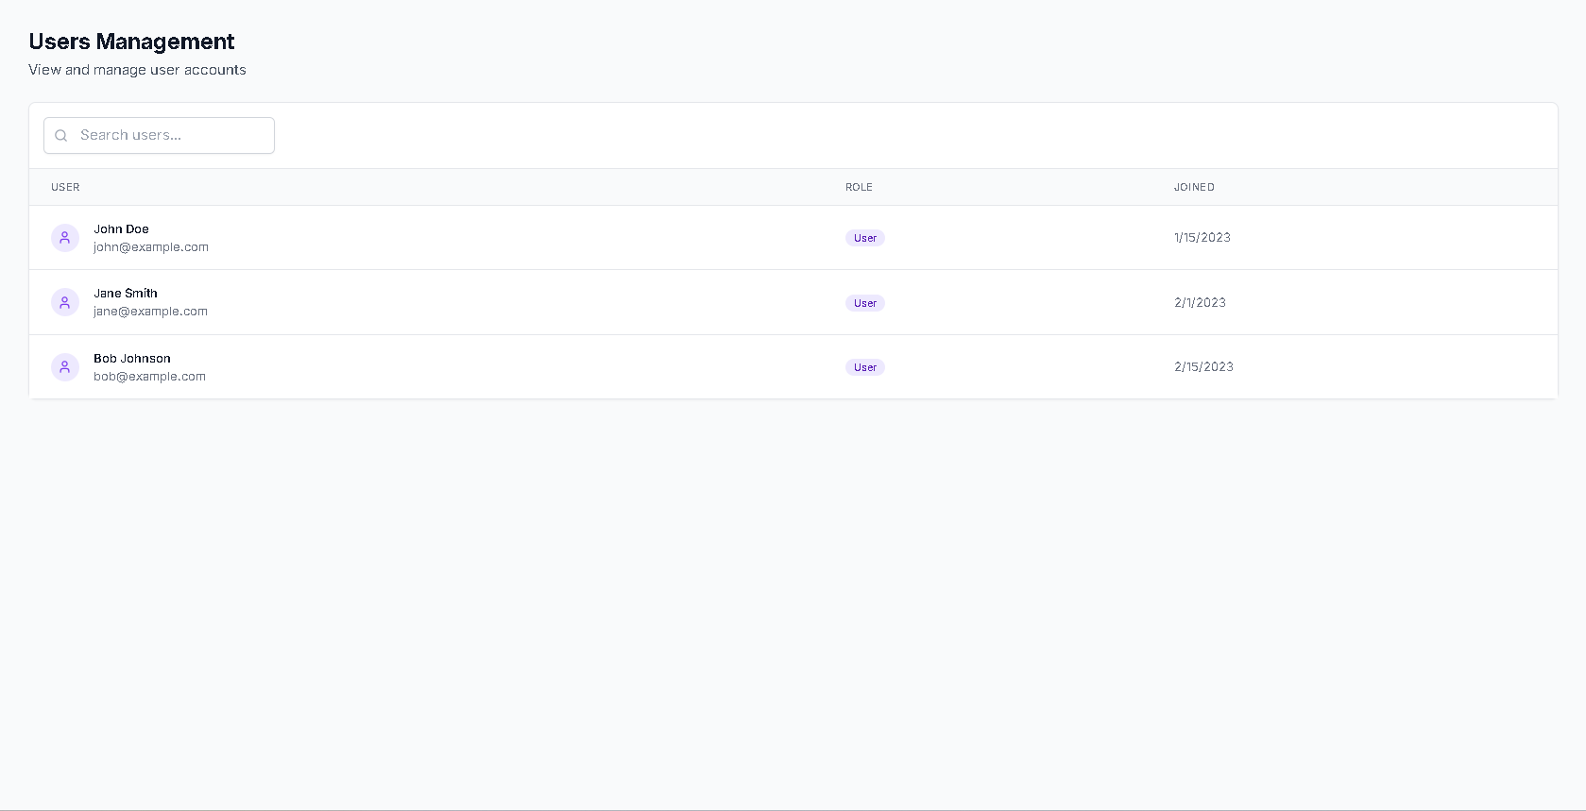
Manage User

Slide 52
BookMyMandap: Let's Create Unforgettable Events Together
Join thousands who trust BookMyMandap for effortless venue booking. Experience the future of event planning with convenience and confidence at your fingertips. Contact us today to learn how we can help make your special day truly unforgettable.

